Slide 1
Cache Memory

Slide 2
Cache Memory
A cache memory is a small fast memory placed between processor and main memory
It can be viewed as a buffer memory for the main memory
Reduce the effective time required by processor to access address instruction or data that are normally stored in main memory
Sometime a cache is used to store instruction but not data, in which case the term instruction cache
The advantage of restricting a cache to instruction because its not change
The CPU first checks the cache for the existence of this word if not request from memory, the main memory will transfer this word to cache with the block of information nearest to this word.

Slide 3
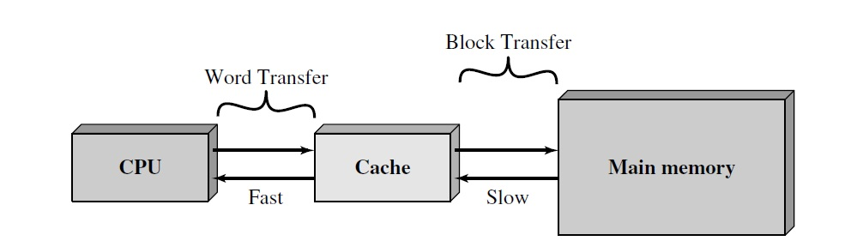
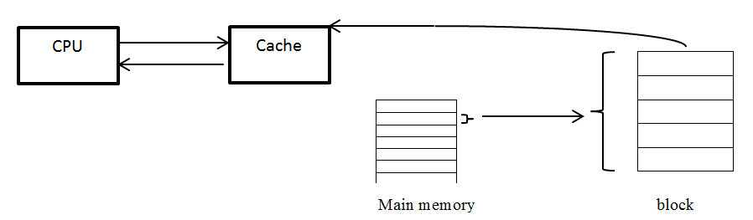
Cache Memory

Slide 4
Cache design
The idea from cache is to keep the most frequently accessed instructions and data in the fast cache memory.
A large fraction of memory requests will be found in the fast cache memory because the locality of reference property of programs.
The cache memory access time is less than the access time of main memory by a factor of 5 to 10.

Slide 5
Principle of Locality of Reference
Over any short period of execution time, the address and data that the program need are referenced in specific area of main memory, but other are discarded not demanded.
Loops, subprograms, subroutines and arrays are exact example for locality of reference this principle increase the hit ratio.
But JMP and GOTO instructions decreases hit ratio because its continuously replace block.

Slide 6
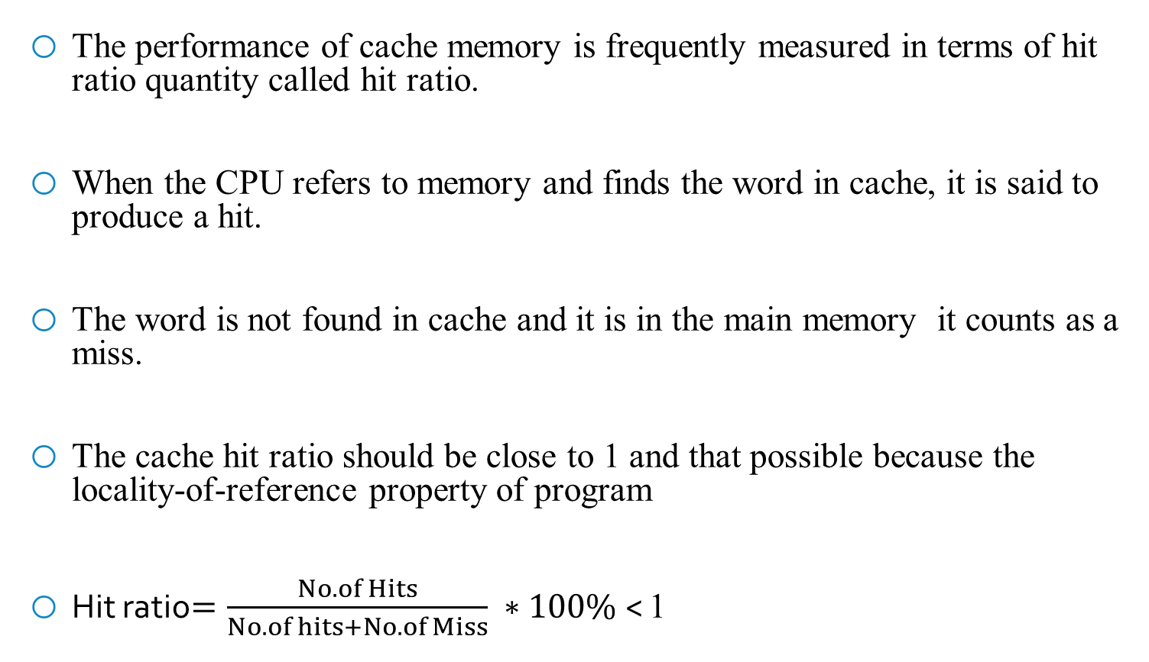
Performance of cache
The performance of cache memory is frequently measured in terms of hit ratio quantity called hit ratio.
When the CPU refers to memory and finds the word in cache, it is said to produce a hit.
The word is not found in cache and it is in the main memory it counts as a miss.
The cache hit ratio should be close to 1 and that possible because the locality-of-reference property of program
Hit ratio$=\frac{No. of Hits}{No. of hits+No.of Miss} ∗100\%$< 1

Slide 7
Performance of cache
The average memory access time of a computer system can be improved considerably by using a cache.
If hit ratio is high enough so that most of time CPU accesses to the cache instead of main memory.
The average access time is closer to the access time of the fast cache memory.
Ts= H × Tc+ (1-H) Tm
Ts: System access time. Tc: Cache access time.
Tm: Main access time. H: Hit ratio.
1-H: Miss ratio.
Ex: A computer with cache access time equal to 90ns, a main memory access time equal to 800ns, and hit ratio equal to 0.9. Find the average access time of system.

Slide 8
Basic operation of cache
When the CPU needs to access to memory, the cache is examined.
If the word is found in the cache, it is read from the fast memory.
If the word addressed by the CPU is not found in the cache, the main memory is accessed to read the word.
A block of words containing the one just accessed is then transferred from main memory to cache memory.
The block size may vary from one word (the one just accessed) to about 16 words adjacent to the one just accessed.
Some data are transferred to cache so that future references to memory find the required words in the fast cache memory.

Slide 9
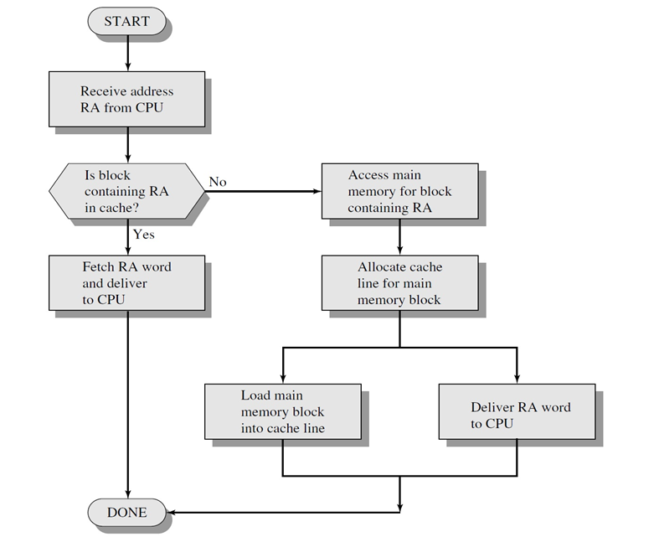

Slide 10
Mapping Function
Because there are fewer cache lines than main memory blocks, an algorithm is needed for mapping main memory blocks into cache lines.
The choice of the mapping function dictates how the cache is organized. Three techniques can be used:
Associative.
Direct.
Set associative.
No. of block in main = (Size main )/(Size of Block )
No. of slot (lines) in cache= (Size of cache )/(Size of Block )

